Slide 1


Development of Hospital Management System for ICDDR’B
IUBAT – International University of Business
Agriculture & Technology
Prepared By
Rafiyatul Rabby Ridam
ID: 18103391
Program: BCSE
Supervised By:
M M Rakibul Hasan
Senior Lecturer
Department of CSE

Slide 2
Organizational Overview
01
03
05
07
09
Requirement
Engineering
CONCLUSION
analysis AND DESIGN
DEMONSTRATION
02
04
06
08
Introduction
PROJECT ESTIMATION
TESTING
FUTURE WORK

Slide 3

Organization
Established in 1960 in Dhaka, Bangladesh.
web solution
software development
mobile application
Vision: “A world in which more people survive and enjoy healthy lives.”

Slide 4

Introduction
Client server web based system.
Provide better services and good keeping of records.
an environment designed for make your mind refresh.

Slide 5
Introduction(Cont.)
The purpose of the project.
Secure and user friendly system.
This presentation generated purpose.
In this presentation I will describe every part of the development parts with proper designs.

Slide 6
Objectives
Main objectives are:
Effective system for the User
To provide a user-friendly system for user, as well as admin and guest.
Keep track on data.
Make user friendly site and comfort.
To reduce Unnecessary Doctor visits.
User Can modify their profile as their wills.

Slide 7
Project Overview and Features
Hospital Management System is specially build for securing user personal information.
Besides the safe data transferring this system helps users to make a delighted communication.
User can take doctor advise remotely which will reduce unnecessary doctor visits.

Slide 8
Proposed System Benefits
Web based application
Platform independent
Easy to manage information
Easy to show all the features & creating also.
Ensures safety of personal information.

Slide 9
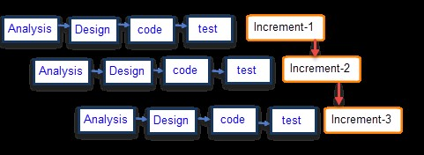
Software Process Model
Figure: Incremental Process Model

Slide 10
Why this model?
There is multiple development cycles take place in incremental model.
It is flexible to change requirements and scope.
Time efficient.
Less errors.
Cost is user friendly.

Slide 11
Feasibility Study
Technical Feasibility
Economic Feasibility
Operational Feasibility

Slide 12
User and System Requirements
For User:
User Can login/register.
User Can manage (Create, View) posts.
User Can manage (View, Update) their profile.
User Can manage (View) post.
User can response to guest’s problems.
User can send message to each other.
User Can manage (Send, Receive) messages.

Slide 13
User and System Requirements (Cont.)
For Admin:
Admin can login.
Admin can (View, Update) their profile.
Admin can manage (View, Block) user.
Admin can manage (View, modify, Delete) post information.
Admin can send message to user.
Admin can manage guest users.

Slide 14
User and System Requirements (Cont.)
For Guest:
Guest can view dashboard.
Guest can submit (Send, Receive)their problems and get response through emails.

Slide 15
Functional Requirements
For Admin:
• Login
• View profile
• View Post List
• View User List
• View Guest List
• Block User
• Unblock User
• Delete Post
• Logout

Slide 16
Functional Requirements (Cont.)
For User:
• Registration
• Login
• View profile
• Edit Profile
• View Post
• Response to guest
• Send messages
• Receive messages
• Logout

Slide 17
Nonfunctional Requirements
User cannot create more than one accounts using the same Mail Address.
System will all store the Mail address and Password in Database.
Admin and User will see their profile information in their profile after login.
The registration will be validated with valid mail address.

Slide 18
Project Estimation

Slide 19
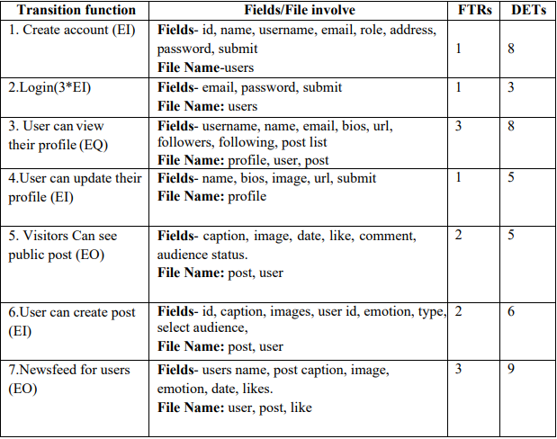
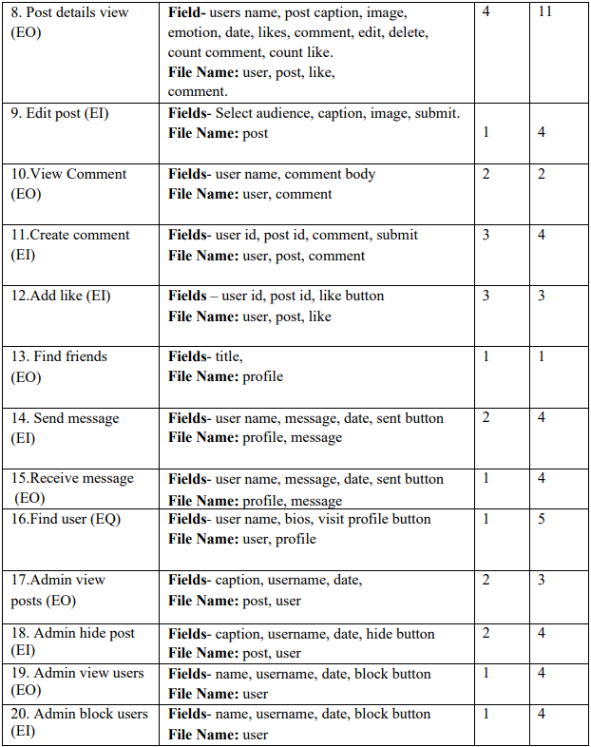
Identifying Complexity for Transaction Function

Slide 20
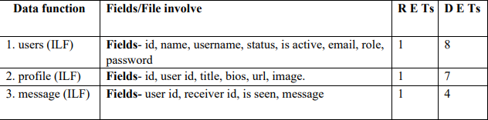
Identifying Complexity for Data Function

Slide 21
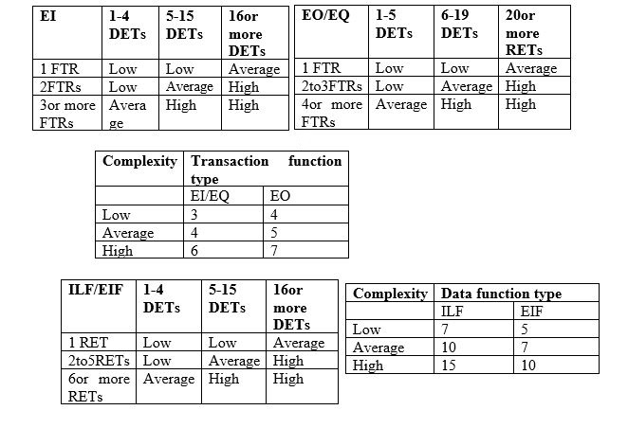
Complexity Weight table

Slide 22
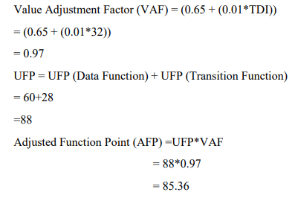
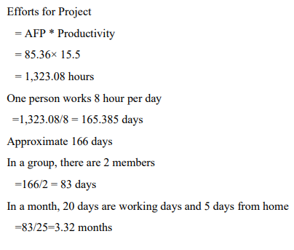
Calculation

Slide 23
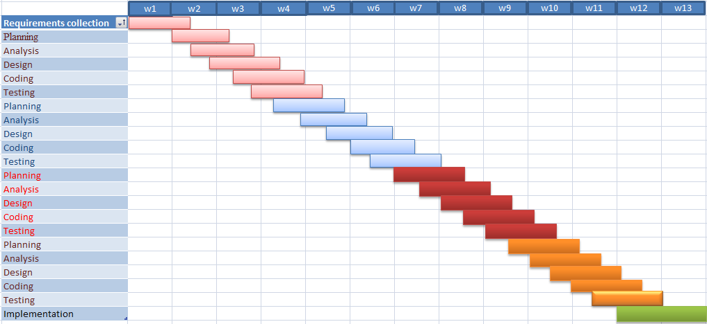
Project Schedule

Slide 24
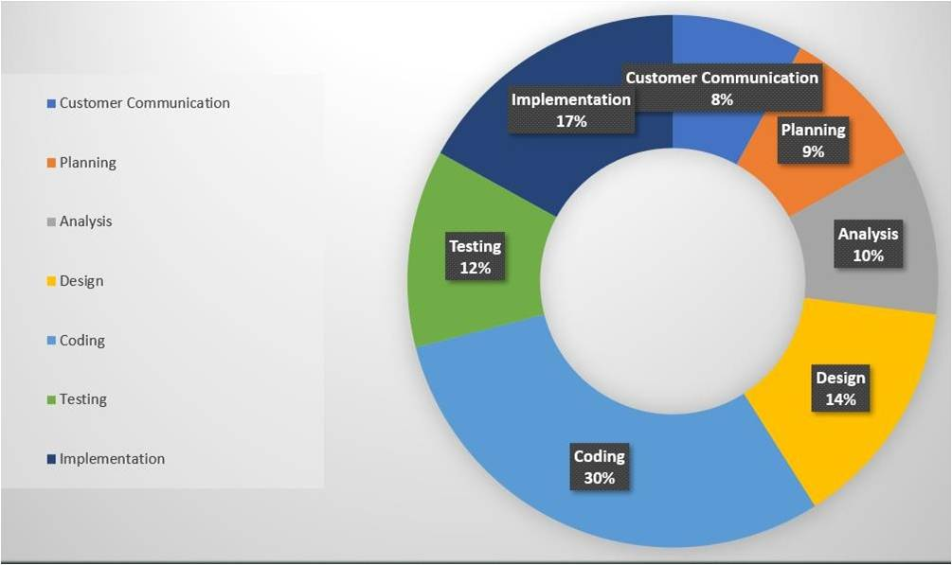
Effort Based Estimation

Slide 25
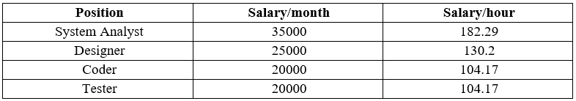
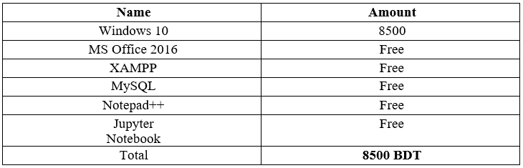
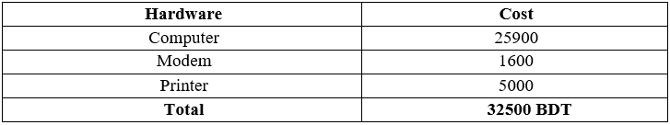
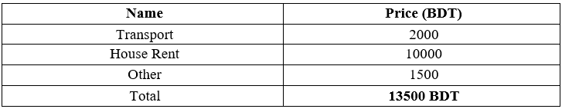
Cost Estimation
Personnel cost
Software cost
Hardware cost
Other cost

Slide 26
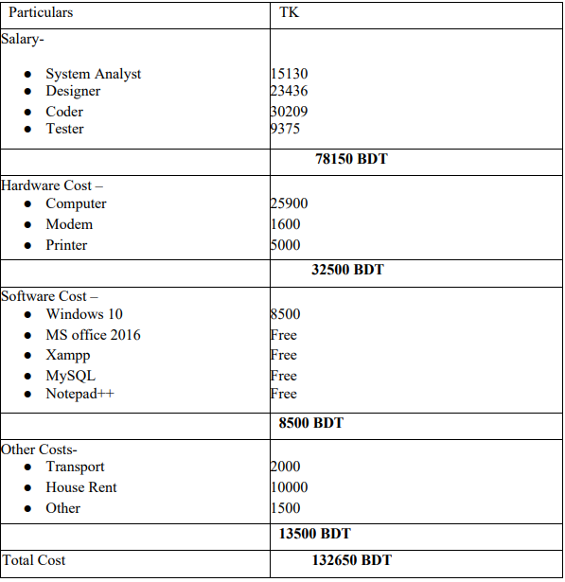
Cost Estimation(Cont.)
Account Table:

Slide 27
Analysis and Design

Slide 28
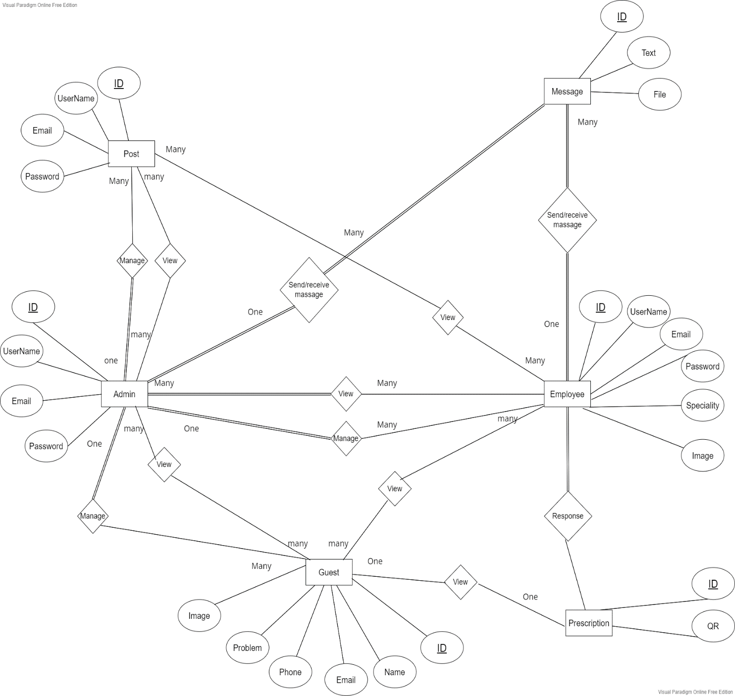
ER Diagram

Slide 29
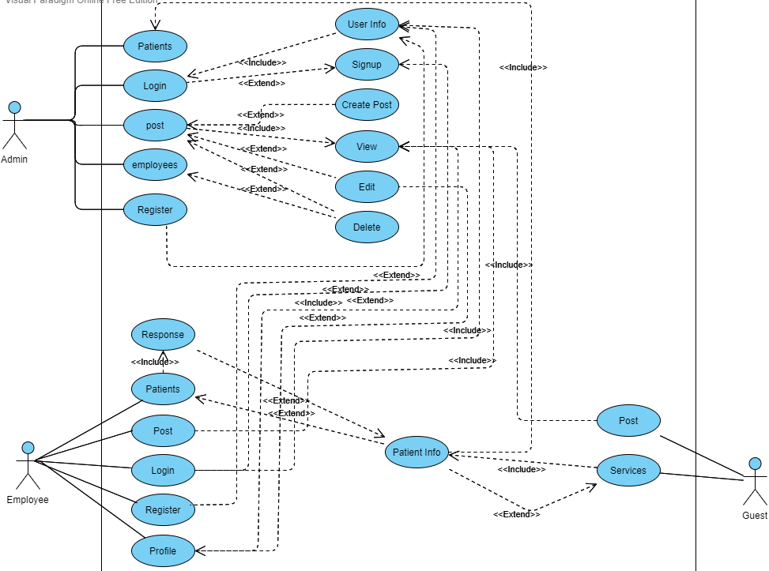
Use Case Diagram

Slide 30
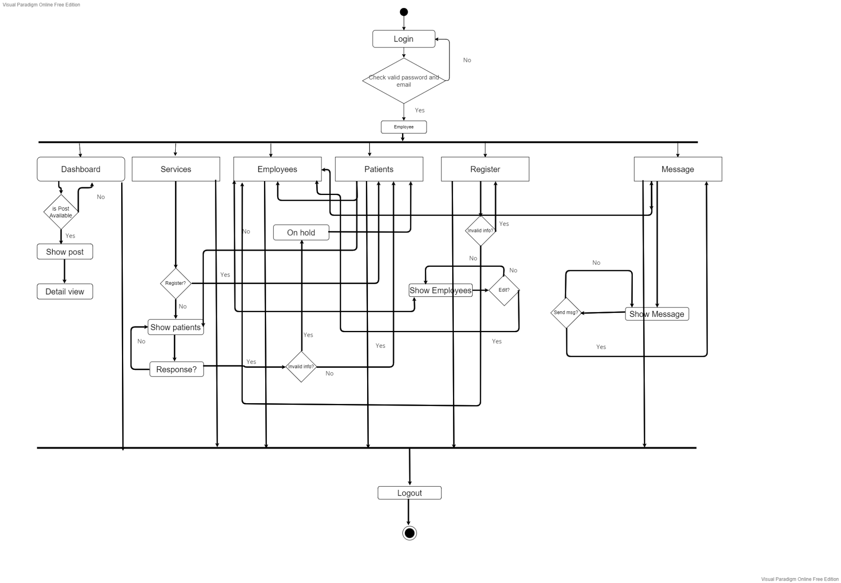
Activity Diagram for Employee

Slide 31
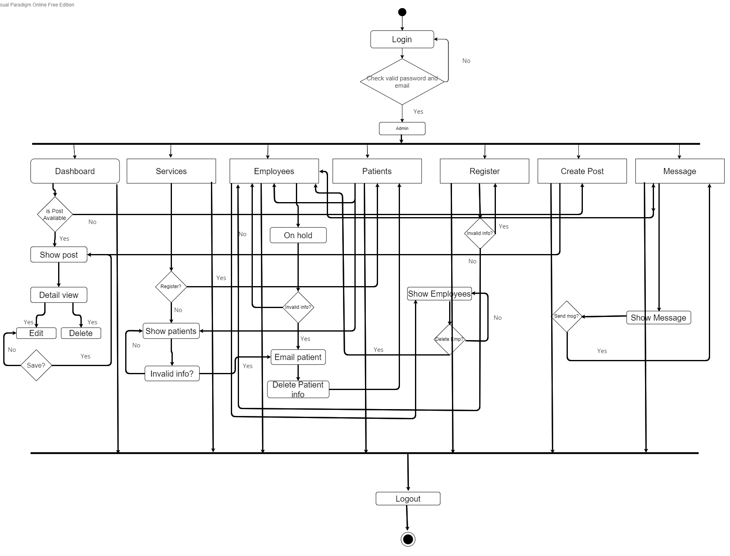
Activity Diagram for Admin

Slide 32
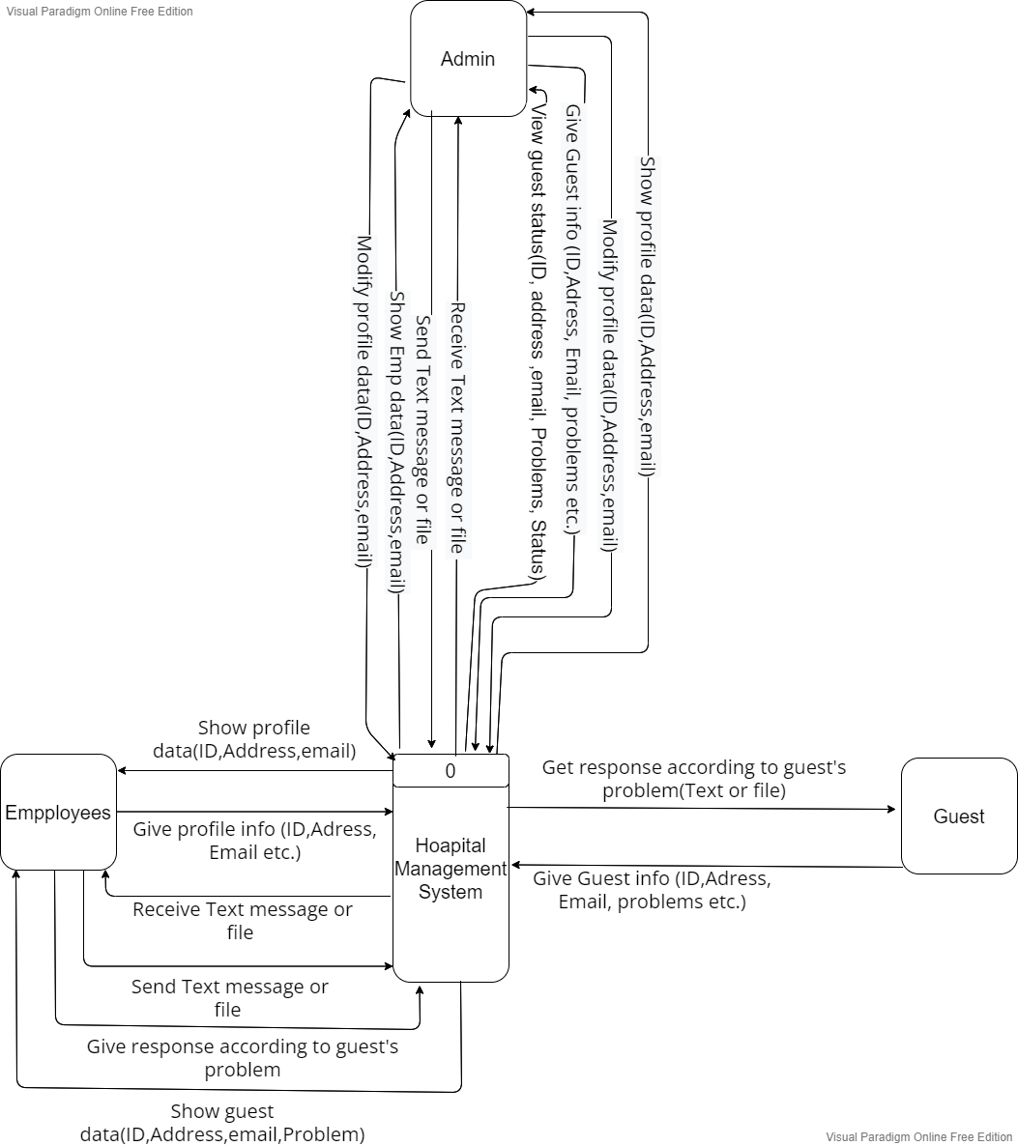
Data Flow Diagram (Context level)

Slide 33
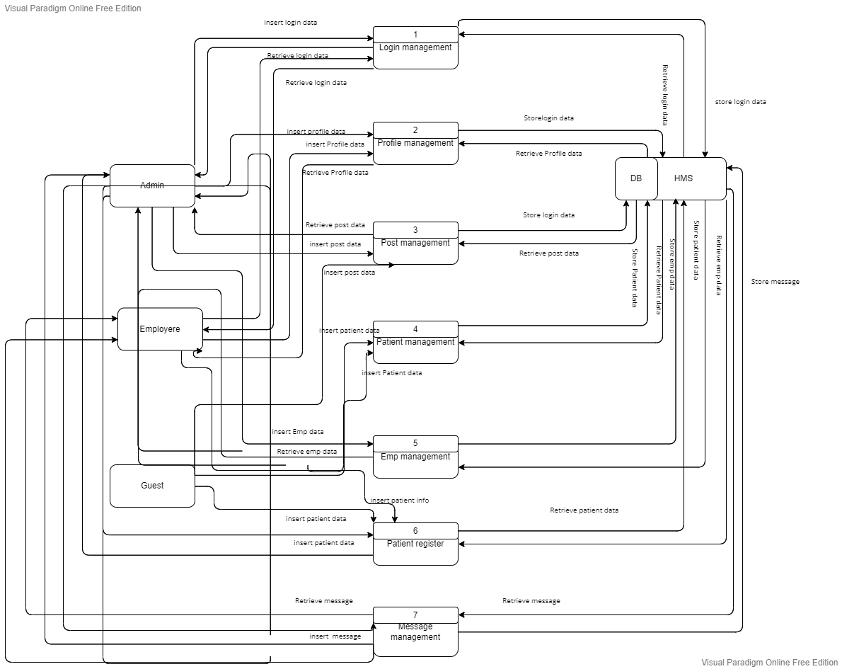
Data Flow Diagram (Level 1 Diagram)

Slide 34
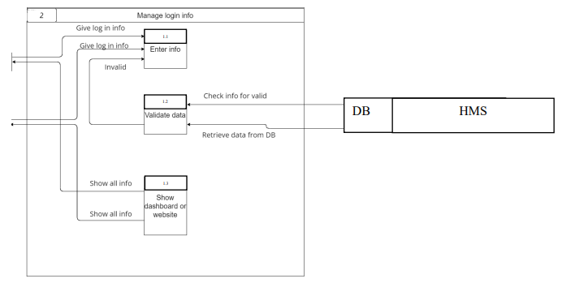
Data Flow Diagram (Level 2 Process 1 Login)

Slide 35
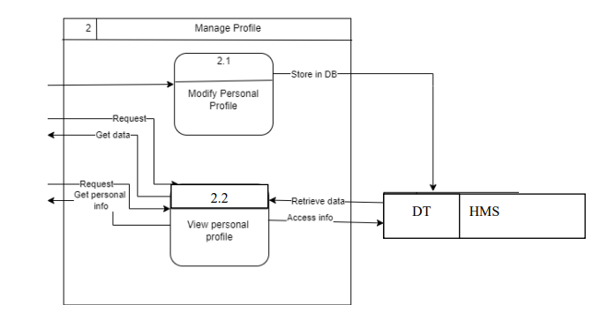
Data Flow Diagram (Level 2 Process 2 Profile)

Slide 36
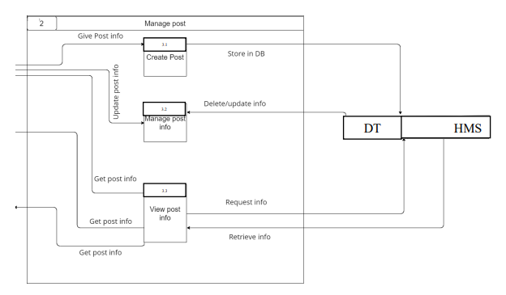
Data Flow Diagram (Level 2 Process 3 Post)

Slide 37
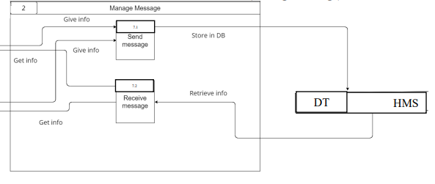
Data Flow Diagram (Level 2 Process 4 Message)

Slide 38
Testing

Slide 39
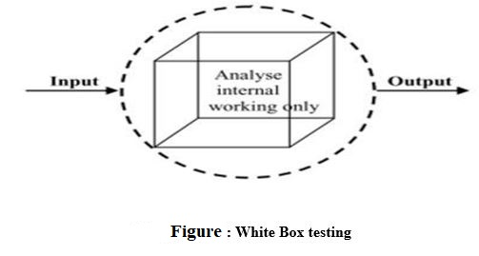
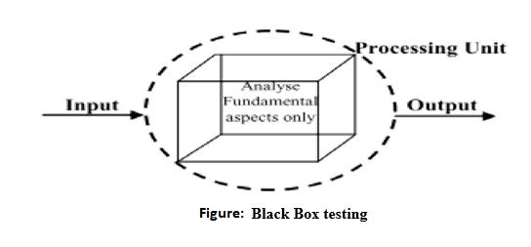
System Testing Methods
White Box Testing
Acceptance Testing
System Testing
Black Box Testing
Unit Testing
Integration Testing

Slide 40
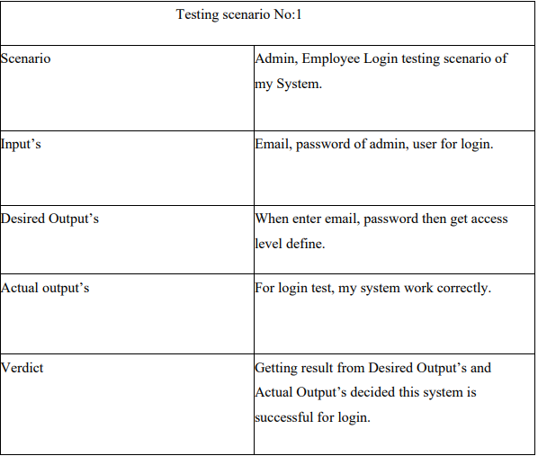
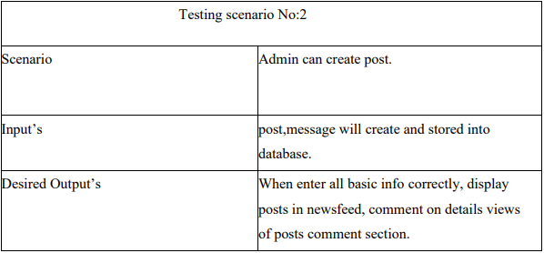
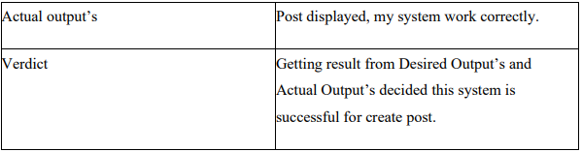
Testing Scenario

Slide 41
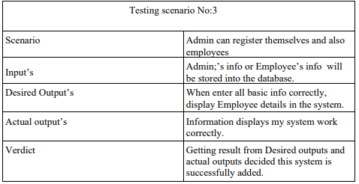
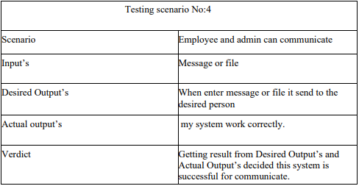
Testing Scenario

Slide 42
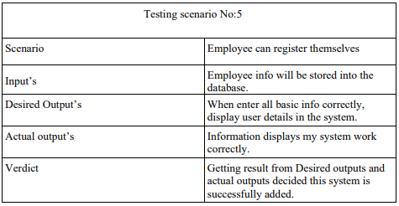
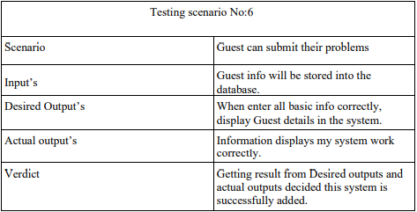
Testing Scenario

Slide 43
Project Demonstration

Slide 44
Limitation
Huge database needed.
This system does not allow any type of calling feature.
Group and Page feature also not in the system.

Slide 45

For each notification there will be specific route.
System will work fast as the more calculation will be added.
Sing in option using third party applications.

Slide 46


